Slide 1

OA3103: Data Analysis
CDR Paolo “Schwarma” Singh, USN
CDR Paolo “Schwarma” Singh, USN, PhD

Slide 2
Welcome to Data Analysis
Statistical modeling (statistical learning) class
Bridges what you learned in OA3101/3102
Tools for advanced methods leading to Machine Learning (OA4106/4118)

Slide 3
Data?
What is data?
Examples?
Input vs Output (response) variables
$$Y=f(x)=β_{0}+β_{1}x_{1}+β_{2}x_{2}$$
$$Y=f(x)=β_{0}+β_{1}x_{1}+β_{2}x_{2}+ε$$
Notes:
1. Data
You can point to each piece:
$x_{1},x_{2}$: observed inputs
$Y$: observed output
$ε$: unobserved noise
Then ask:
“Which of these do we actually get to see? Which do we never see?”
This immediately grounds the course in the reality of data work.

Slide 4
Inference vs Prediction
So far we’ve probably done a lot with inference
Given input variables/parameters, what can we say about certain parameters and their effect on the output?
Examples?
$$Y=f(x)=β_{0}+β_{1}x_{1}+β_{2}x_{2}+ε$$
Notes:
2. Inference
Inference is about the parameters:
What is $β_{1}$?
What is $β_{2}$?
Are they positive? Negative? Zero?
How certain are we?
What assumptions do we need?
You can say:
“Inference is about learning the structure of the world.”
This is the OA3102 → OA3103 bridge.

Slide 5
Prediction
Given input variables, what can we expect the output variable to be?
Examples?
$$Y=f(x)=β_{0}+β_{1}x_{1}+β_{2}x_{2}+ε$$
Notes:
3. Prediction
Prediction is about the output:
Given new $x_{1},x_{2}$, what do we expect $Y$to be?
How accurate can we be?
How much uncertainty remains?
What happens when the model is wrong?
You can say:
“Prediction is about learning what will happen next.”
This is the OA3103 → OA4106 bridge.

Slide 6






Regression and Classification
Regression
Classification
$$y$$
$$x_{2}$$
$$y$$
$$0 1$$
$$x$$
$$x_{1}$$
Source: An Intro to Spectral Convolution Neural Networks by Dr. Patrick McClure

Slide 7







Model: Linear
Regression
Linear Regression Model
Classification
Logistic Regression Model
$$y$$
$$x_{2}$$
$$y$$
$$0 1$$
$$x$$
$$x_{1}$$
$$p\left(y=1 | x\right)=sigmoid\left({w_{1}x}_{1}+{w_{2}x}_{2}+b\right)=\frac{1}{1+e^{{w_{1}x}_{1}+{w_{2}x}_{2}+b}}$$
$$\hat{y}=wx+b$$
Source: An Intro to Spectral Convolution Neural Networks by Dr. Patrick McClure

Slide 8
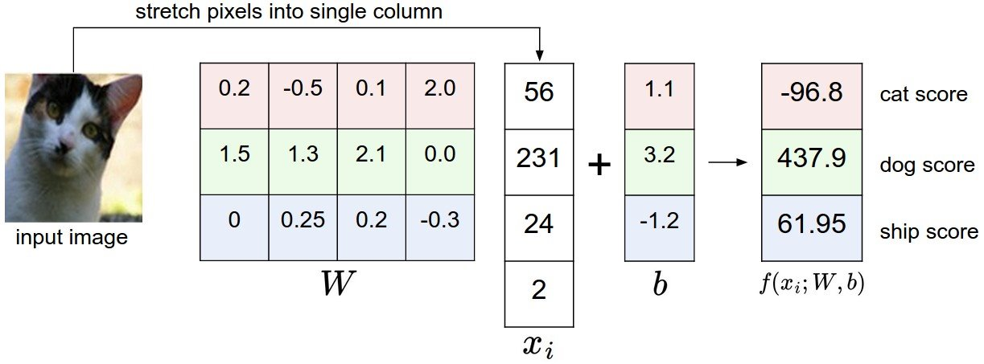

Model: Linear Classification
cat logit
dog logit
ship logit
Source: An Intro to Spectral Convolution Neural Networks by Dr. Patrick McClure

Slide 9
Data: Non-linear
Regression
Classification
$$y$$
$$x_{2}$$
$$y$$
$$0 1$$
$$x$$
$$x_{1}$$
Source: An Intro to Spectral Convolution Neural Networks by Dr. Patrick McClure

Slide 10

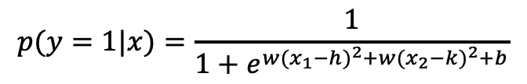
Model: Non-linear
Regression
Classification
$$y$$
$$x_{2}$$
$$y$$
$$0 1$$
$$x$$
$$x_{1}$$
$$p(y=1|x)=\frac{1}{1+e^{w{(x_{1}−h)}^{2}+w{(x_{2}−k)}^{2}+b}}$$
$$\hat{y}=w{(x−a)}^{2}+b$$
Source: An Intro to Spectral Convolution Neural Networks by Dr. Patrick McClure

Slide 11
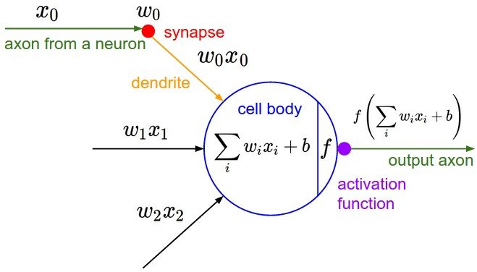


Model: Fully-connected Neural Network Layer
0
$$σ($$
$$)$$
Non-Linearity
Source: An Intro to Spectral Convolution Neural Networks by Dr. Patrick McClure

Slide 12
Reproducibility and Defensibility
Reproducibility (What we do):
Same code + Same data = same results
Clear workflow
Document our assumptions, transformations, and decisions
Your future self (and others) should be able to rerun the analysis without guessing
Defensibility (What we explain):
To our customer / Commander
Why this model?
What assumptions does our method rely on?
What alternatives did we consider?

Slide 13
Syllabus and Roadmap for the Quarter

Slide 14
Expectations of you
Come prepared
Engage (not just attend)
Be honest and humble (i.e. ask questions!)
Communicate
Mulligan policy
Learn something every day
Look out for each other

Slide 15
Programming Software
Python is the primary workflow (ISLP textbook)
R is essential for OA4106 next quarter
We will work with both
VS Code / Github Codespace
Assignments
May be done in either Python or R
Some small tasks will explicitly ask for both

Slide 16
Expectations of Me
First time teaching the course
I’ve taken it with both Bob Koyak and Robert Bassett
Course is evolving
Intent: We will learn a lot together
Open and upfront
My contract to you: No BS
Prof. Alderson’s guidance

Slide 17
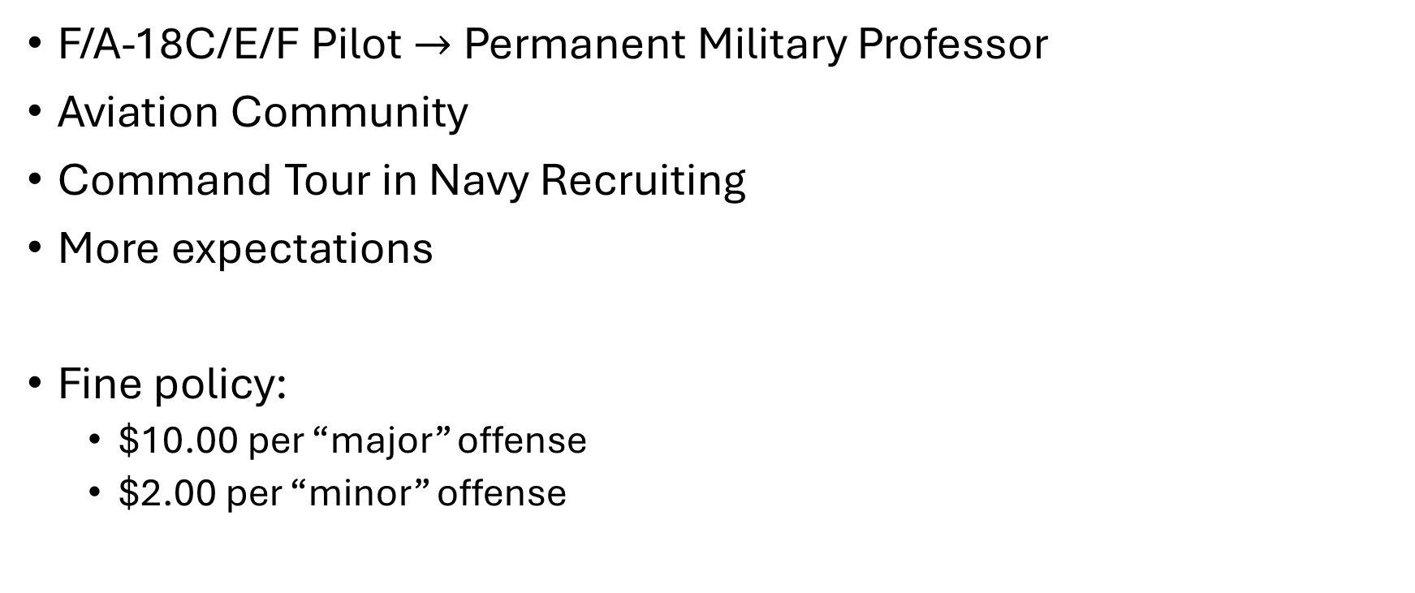
How do you know when a Fighter Pilot walks into a room?
F/A-18C/E/F Pilot $→$Permanent Military Professor
Aviation Community
Command Tour in Navy Recruiting
More expectations
Fine policy:
$10.00 per “major” offense
$2.00 per “minor” offense

Slide 18
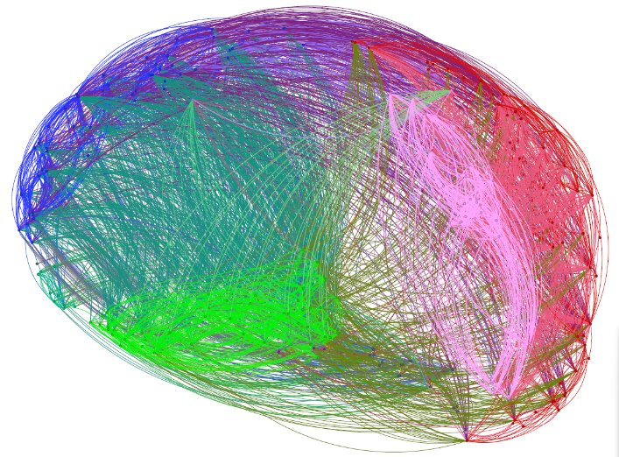
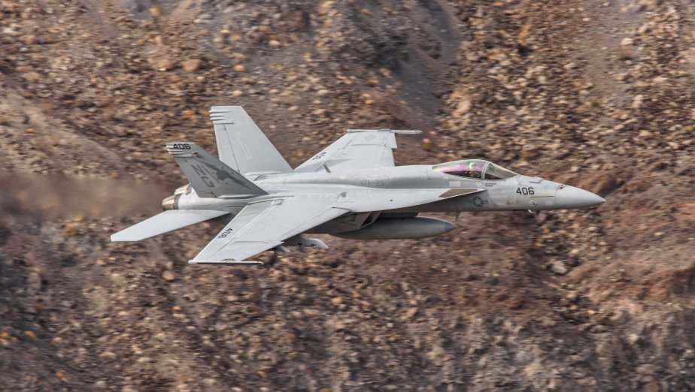
Questions?

